Slide 1

Disney+ & Hotstar Analysis
By Adithyaa Swaminathan

Slide 2
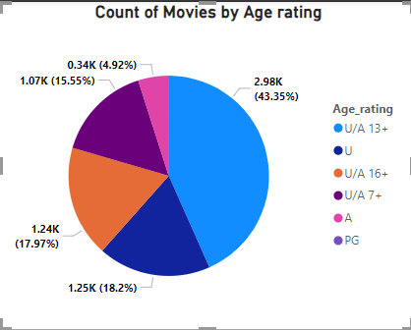
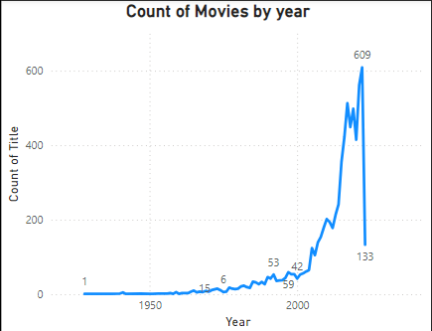
The graph below shows the number of movies over the years from 1928 to 2023
The above chart depicts the spread of Age rating over Movies and Tv shows
U/A 13+ leads and constitutes to 43.35%

Slide 3
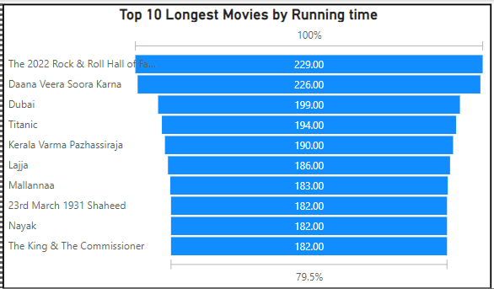
Top 10 longest movies based on the run time where 2022 rock and roll hall of fame has a run time of 229 minutes

Slide 4
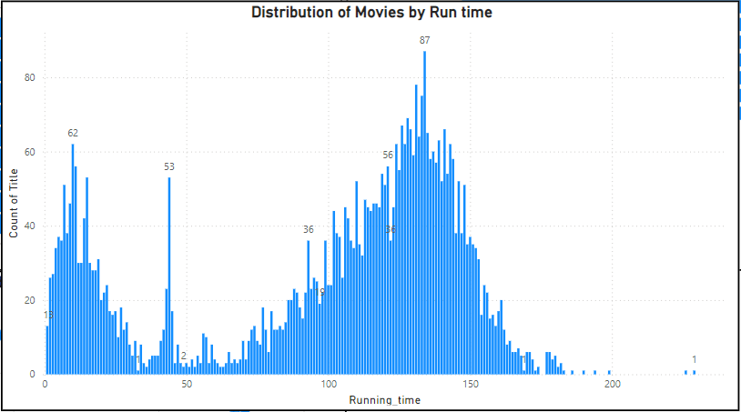
The above Graph shows the distribution of movies and their running time

Slide 5
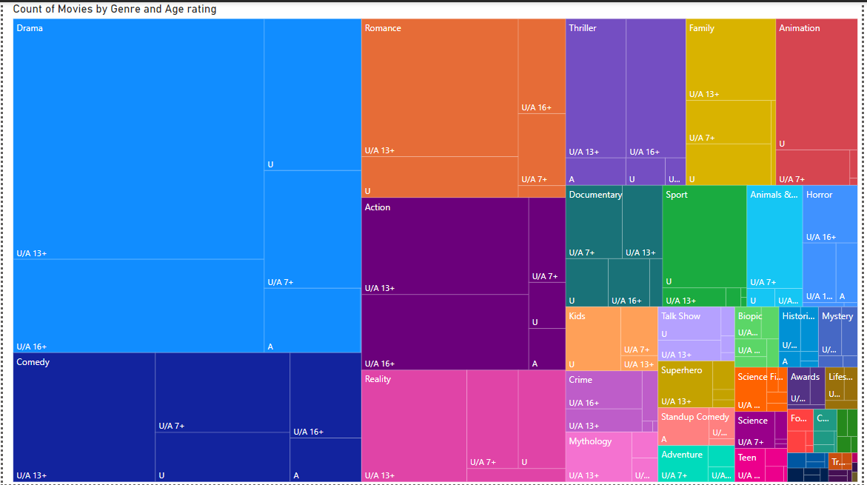
The above tree map shows the spread of movies and Tv shows based on Genre and Age Rating out of which Drama tops the list and followed by Comedy and Romance

Slide 6
